Slide 1
BGP Withdraw Solution

Slide 2
Contents
Introduction
What is BGP withdraw?
When is BGP withdraw required?
E2E flow
Diversion
Deactivation
Radware/Customer BGP Withdraw setup

Slide 3
Introduction - BGP Withdraw Solution
What is the BGP Withdraw Solution?
Automatic diversion trigger using conditional advertisement.
BGP conditional advertisement allows to control which route to advertise if a preferred route is not available in the local BGP routing table, indicating a peering or reachability failure.
Configuration necessary on the client-side routers.
Radware to completely pull all of the customer’s traffic while simultaneously stopping all advertisement and traffic flow to the client’s ISP.
When to use BGP Withdraw Solution?
Utilized when client ISP is unable to wholly or partially release client traffic.
Utilized after local preference or prepends do not enable Radware to be the best path.
Conditional advertisement reference from Cisco:
http://www.cisco.com/c/en/us/support/docs/ip/border-gateway-protocol-bgp/16137-cond-adv.html

Slide 4
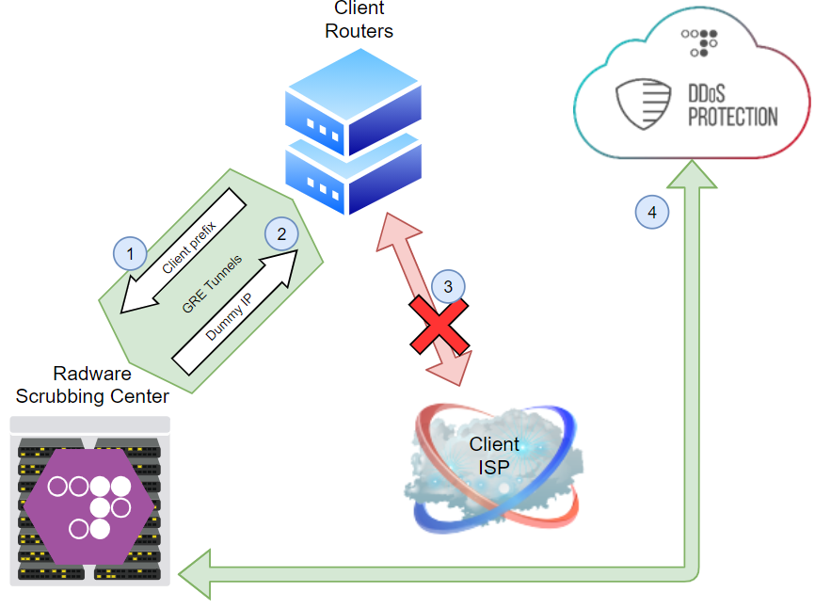
E2E flow: Diversion
Client’s prefix diverts to Radware DDoS Cloud using BGP over GRE.
Client’s BGP advertisement to Radware triggers Radware to advertise dummy IP back to the client over GRE tunnels.
Dummy IP advertisement stops client prefix advertisement to client’s ISP.
Customer prefix is now advertised only to Radware SC.

Slide 5
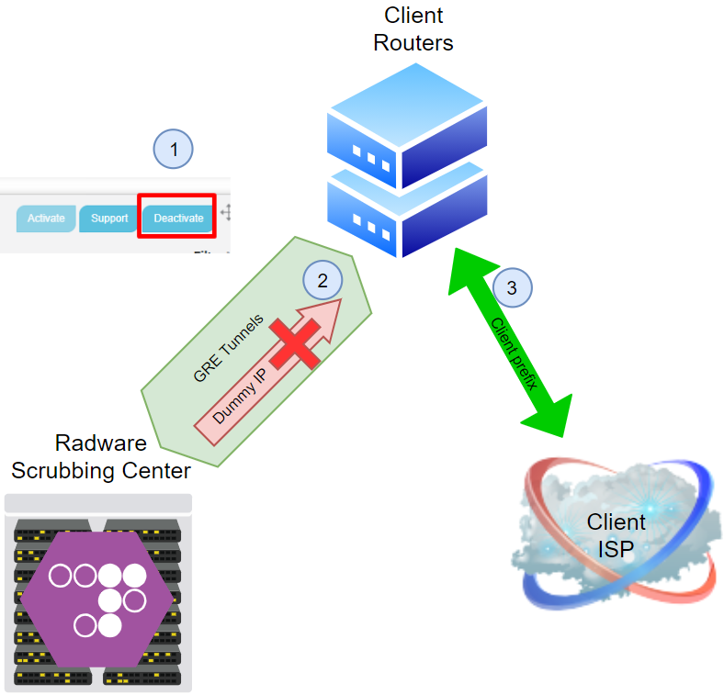
E2E flow: Deactivation
ERT-NOC / client clicks DEACTIVATE in Cloud DDoS Portal.
Radware stops dummy IP advertisement and causes conditional forwarding to stop.
Customer stops BGP advertisement
Traffic un-diverts from Radware scrubbing center and diverts to client ISP.
Note: Customer stopping BGP announcement to Radware without undivert action in the portal would result in blackhole of the prefix

Slide 6
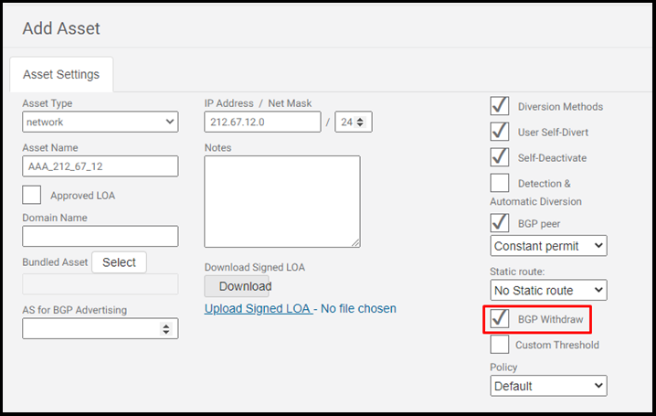
BGP withdraw setup
In this guide the examples will refer to customer prefix 212.67.12.0/24
Radware configurations
Create new asset with BGP Withdraw option checked
Customer configurations
Configure 2 access lists
Associate route maps to access lists
Create conditional routing to enable the dummy IP trigger to stop advertising to client ISP
** Detailed instructions in next slide

Slide 7
Customer Router Configuration
Step 1 is to create access lists, step 2 is to associate route maps to access lists (asset & dummy IP)
Step 3 and 4 are to create conditional routing to enable the dummy IP trigger to stop advertising to client ISP
1) Configure 2 access lists:
3) This command to be configured on the GRE tunnel’s BGP neighbor:
access-list 1 permit 212.67.12.0 0.0.0.255 (asset)
access-list 2 permit 10.212.67.12 (dummy IP)
neighbor [Radware GRE tunnel neighbor IP] advertise-map ADVERTISE exist-map NO-EXIST
2) Create 2 route maps for the access lists:
4) This command to be configured on to the client-ISP neighbor:
route-map ADVERTISE permit 10
match ip address 1
route-map NO-EXIST permit 10
match ip address 2
neighbor [ISP neighbor IP] advertise-map ADVERTISE non-exist-map NO-EXIST

